Slide 1

EIFL webinar:
Discounted & waived apcS from SAGE
Romy beard
Licensing programme manager

Slide 2
agenda
Context
The SAGE offer
How to find the journals included in the offer
Finding the exact cost of the APC to be paid for those authors that qualify for a discount
Submitting journals for publication and requesting for the discount or waiver to be applied
Questions & Answers

Slide 3
1. context
The EIFL Licensing Programme negotiates agreements with publishers and service providers on behalf of EIFL member consortia and their institutions
To support the global move to OA and help speed up the transition to OA we have started negotiating agreements for discounted and waived APCs for EIFL researchers

Slide 4
EIFL agreements for discounted and waived APCs
SAGE
https://eifl.net/e-resources/sage-apcs-open-access-journals
Taylor & Francishttps://eifl.net/e-resources/taylor-francis-apcs-open-access-journals

Slide 5
What are apcs?
An Article Processing Charge (APC) is a fee that authors pay in order to have their article published in open access
APCs cover the cost of article publication including but not limited to running peer-review systems, copyediting and typesetting, hosting the article in perpetuity on dedicated servers and marketing.
The APC is paid after an article has been peer-reviewed and accepted for publication.

Slide 6
Open access vs closed access
If an author publishes their article in a subscription (closed access) journal, they do not pay an APC – however, only those with a subscription to the content can read the article
If an author publishes their article in an open access (either in a fully open access journal, or within a hybrid journal), they usually have to pay an APC – then everyone can read the article, no need to pay for access
Note: some open access journals do not charge article processing charges

Slide 7
Advantages of publishing in open access
Anyone from around the world can read the published article
No subscription costs for libraries
Greater exposure means a higher usage of open access content (more downloads), more citations, more references… more impact on other researchers!

Slide 8
Who pays the apcs?
APCs are paid by research funders, through research grants
Authors paying APCs out of their own pocket
Institutions paying APCs on behalf of their researchers
Within the transition to open access, increasingly libraries are taking charge of the APC spend in their discussions with publishers, through transformative agreements

Slide 9
2. The SAGE offer - waivers
For authors from: Botswana, Cambodia, Congo, Ethiopia, Fiji, Georgia, Ghana, Ivory Coast, Kenya, Kosovo, Kyrgyzstan, Laos, Lesotho, Malawi, Maldives, Moldova, Nepal, Senegal, Serbia, Sudan, Tanzania, Uganda, Ukraine, Uzbekistan, Zambia, Zimbabwe.
Conditions:
The waiver applies only when ALL authors collaborating on an article are from one of the eligible countries. ​

Slide 10
The sage offer – 20% discount
For corresponding authors from: Azerbaijan, Belarus, Estonia*, Kosovo, Latvia*, Lithuania*, Macedonia, Moldova, Palestine*, Serbia*, Slovenia*, Ukraine
Conditions:
The discount is available to corresponding authors from institutions that have a current subscription* to one of the SAGE journals packages offered via EIFL.
This discount cannot be combined with any other, such as Society discounts, promotional discounts or prepaid order discounts. If the author is entitled to or claims multiple discounts, the highest single discount will be applied.
*countries with institutions that have active subscriptions

Slide 11
Corresponding author
Corresponding author:
the main contact, if more than one author work on article together
the author who receives email updates about the article’s process during the peer review and production process
the author who will receive the peer review decision on the article and production proofs to check

Slide 12
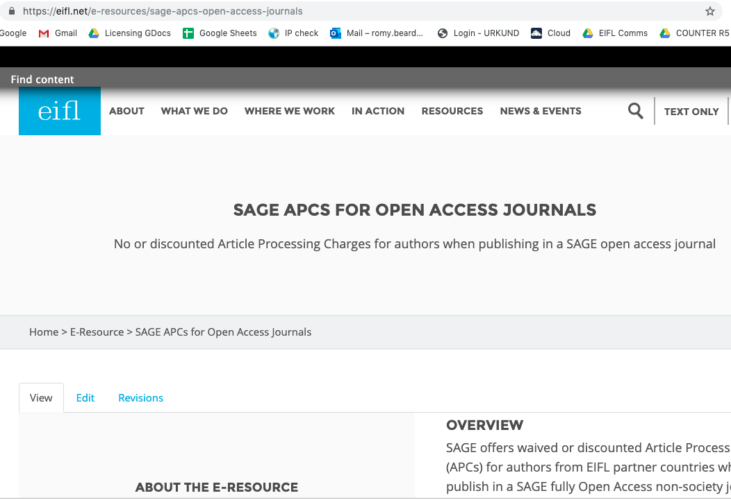

Slide 13
3. How to find the journals included in the offer
191 fully open access journals

Slide 14
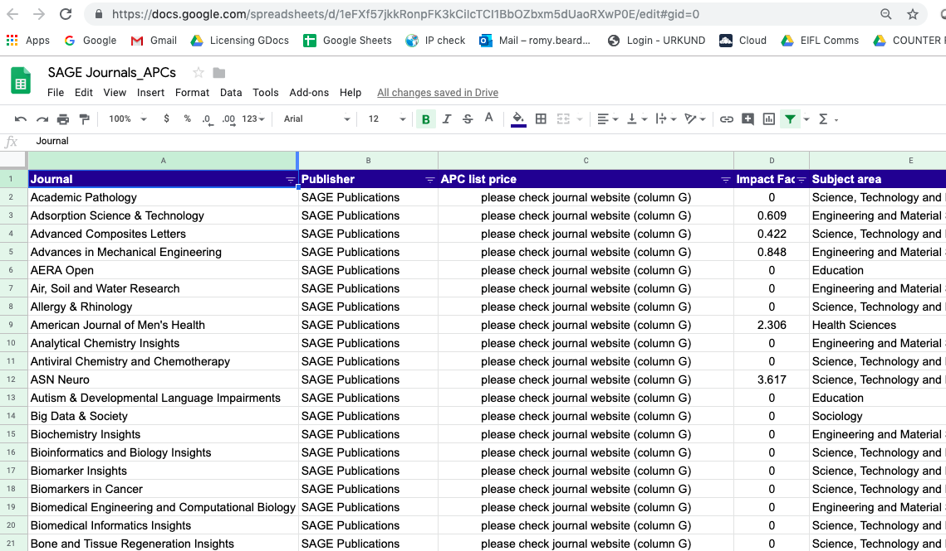

Slide 15
Finding the exact cost of the APC to be paid for those authors that qualify for a discount
If there is a promotional discount, check which discount is higher and use the highest one (only one discount can be used).

Slide 16
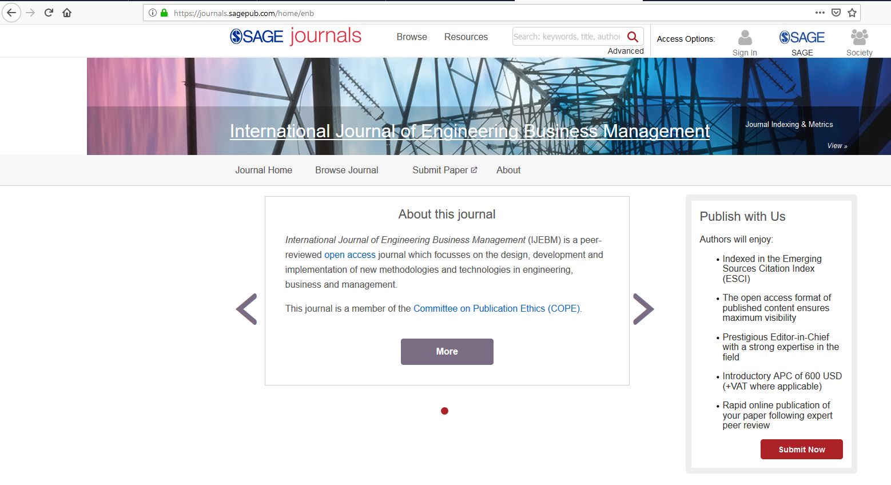

Slide 17
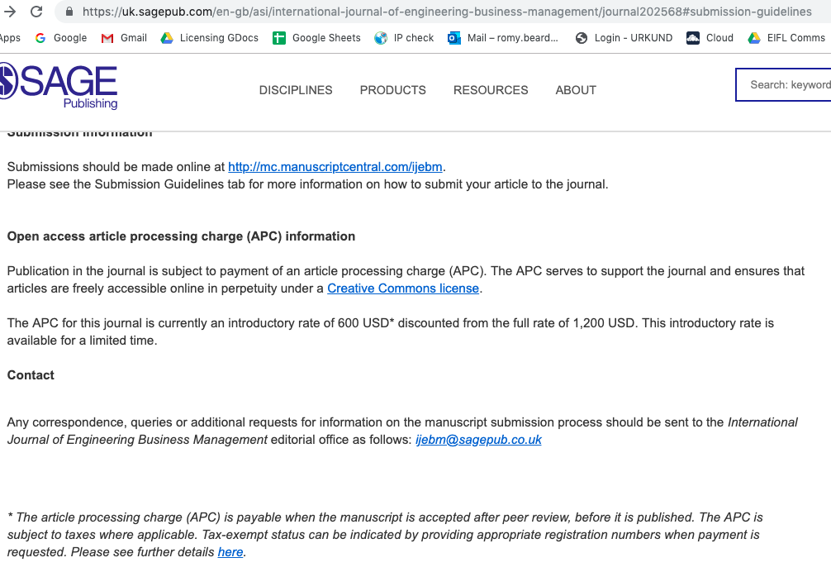

Slide 18
4. Submitting articles for publication and requesting for the discount or waiver to be applied

Slide 19
All EIFL authors will be directed to a payment page upon acceptance of their article, through a URL in an automated email.
If you have any issues with your discount or waiver, simply email APCqueries@sagepub.com.
If you’re eligible for a discount, you must enter the discount code EIFLOA before checking out.
If you’re eligible for a waiver, the waiver will be applied automatically but you will still need to “check out”.

Slide 20
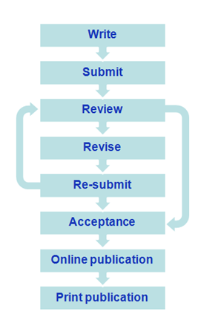
DISCOUNTED apcS
Once your paper is accepted, you will receive an email containing a URL to take you to your APC payment page.

Slide 21
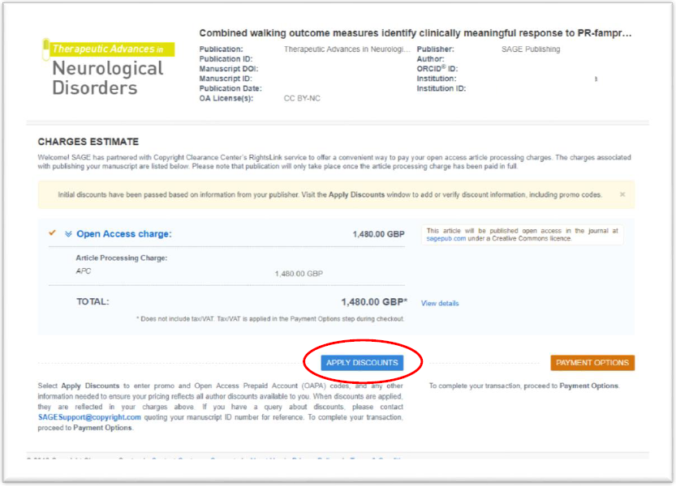

Slide 22
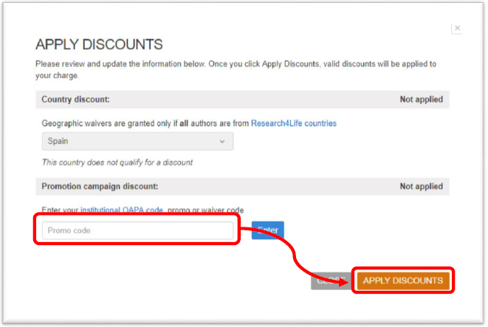
Promo code: EIFLOA

Slide 23
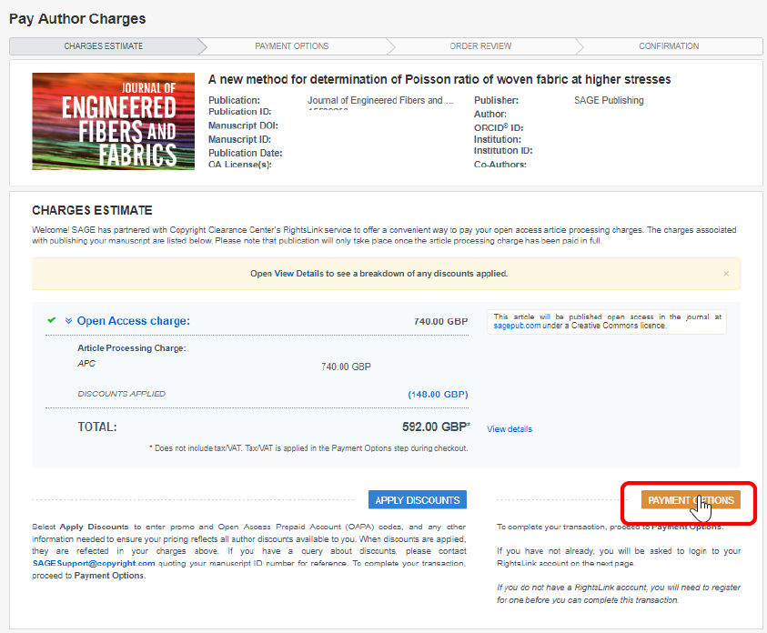

Slide 24
discounted apcS
Your EIFL discount (20% off full list-price of APC) cannot be combined with any other discounts.
Therefore, if there are other discounts on the APCs for your chosen journal, you should use whichever offers you the higher discount, even if that is not the EIFL discount!

Slide 25
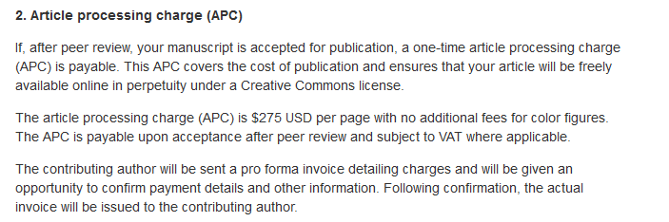
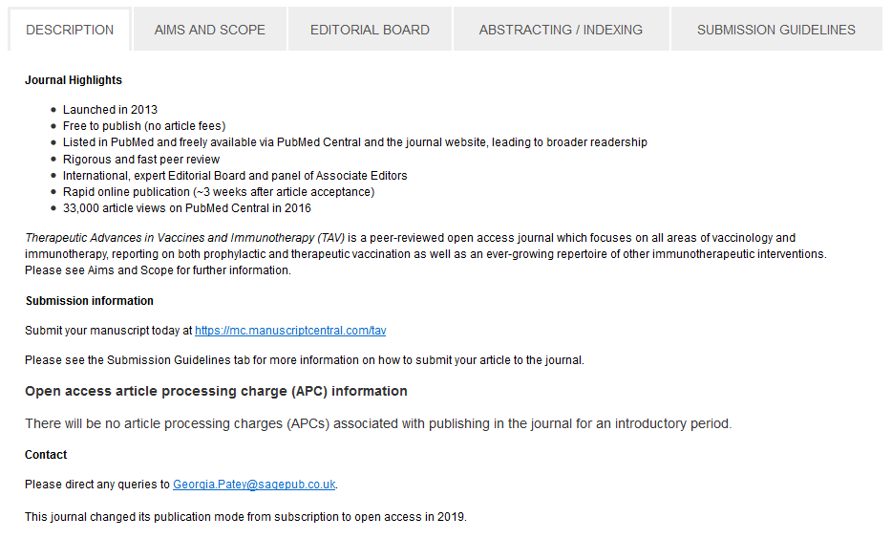
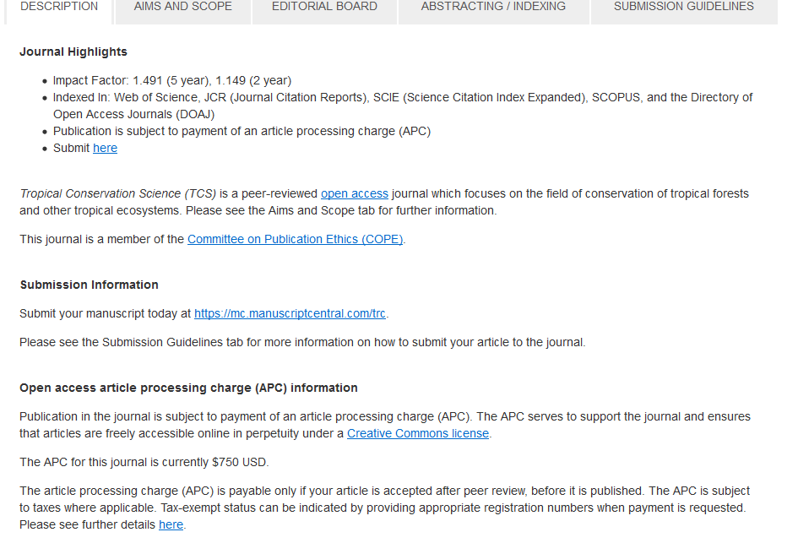
APC special ter

Slide 26
Waived apcS
Upon acceptance, you will receive a URL within an email.
If criteria have been met (all authors from eligible countries), the APC fee will be waived automatically – you just need to complete the payment process on a £0 fee.

Slide 27
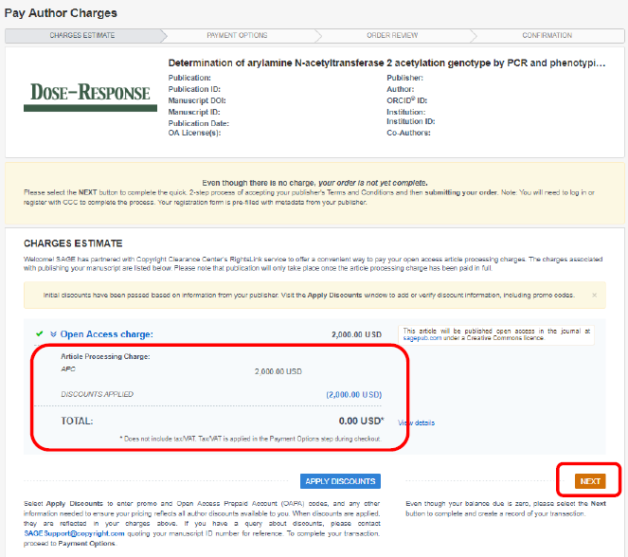

Slide 28
Waived apcS
Sometimes the system does not automatically apply the waiver (for example, if the system has not accurately identified the affiliation of a corresponding author).
If you believe you are eligible for a waiver but the system has not applied it, simply abandon the check-out process and email APCqueries@sagepub.com for assistance.

Slide 29
Questions?
Romy Beard
Licensing Programme Manager
romy.beard@eifl.net

